Slide 1
The Design of New Prosperity and Better Lives
A Workshop for a
“Food-Shelter-Clothes” Birth to Birth System
Cittadellarte, Biella, Italy
15, 16, 17 (and 18) October 2010
Prof. Simonetta Carbonaro
Design Management & Humanistic Marketing
The Swedish School of Textiles
University of Borås , Sweden
REALISE strategic consultants, Karlsruhe, Germany
REALISE THS-HB
Notes:
As you know, the aim of our workshop is to build a network and to produce proposals for research and projects related to our core hypothesis, which is that we must work to decrease conflicts and simultaneously develop synergies between the often competing and disharmonious food/water-shelter-clothing production and use systems. In support of that aim we will both open the workshop, and inject at various times during our two days together, with provocations/statements from our delegates in response--positive, questioning, or negative--to our thesis.

Slide 2
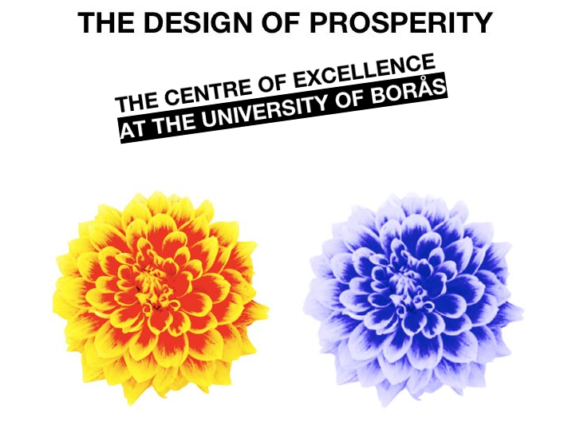

Slide 3
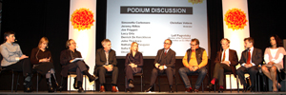
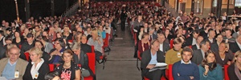
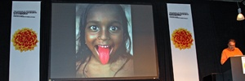
More than 700 people, including 300 delegates of companies and organizations, and more than 50 international scholars attended TDP conference on November 7, 2006

Slide 4
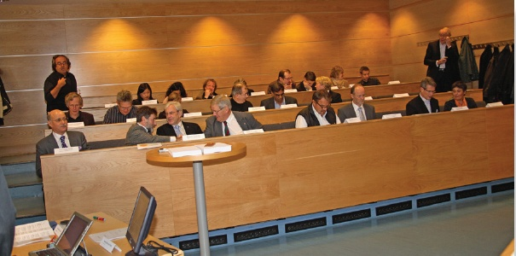
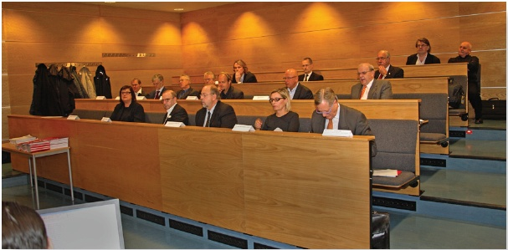
15 cultural leaders and scholars
meeting
14 Entrepreneurs/Executives,
4 Politicians/Policy Makers,
4 Organizations’ Representatives,
3 Universities’ Deans/Rectors

Slide 5
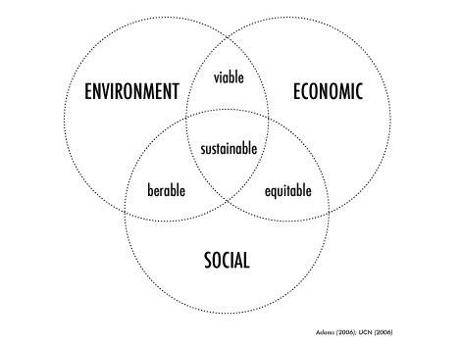
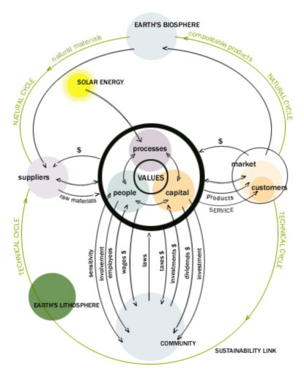
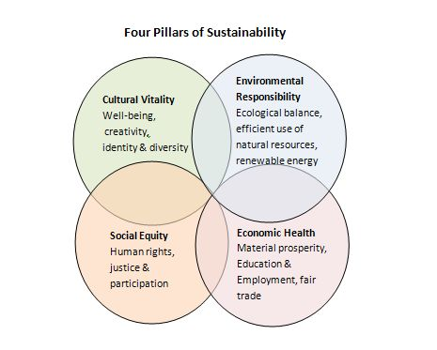
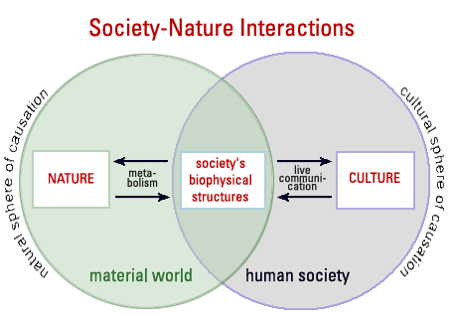
The Interface Model
© 2009 Alpen-Adria-Universität Klagenfurt

Slide 6
CULTURE
Politics
Science
Arts
Economy
…
SOCIAL
SYSTEM
ECOLOGICAL
SYSTEM
PERSONAL
SYSTEM
HABITAT OF ALL LIVING
SPECIES
RISPONSIBILITY

Slide 7
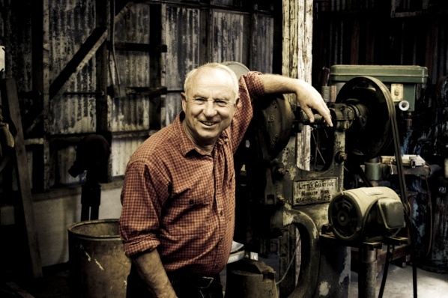
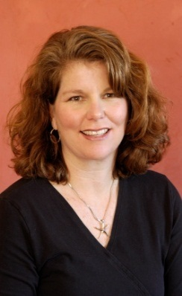
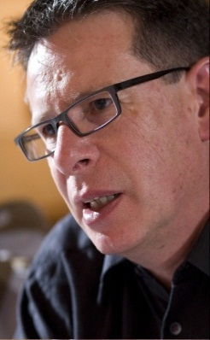
The Design of Prosperity 2009 CONFERENCE The sustainability of our present future
The speakers…
Jill Dumain
Peter Waeber
Yvon Chouinard

Slide 9
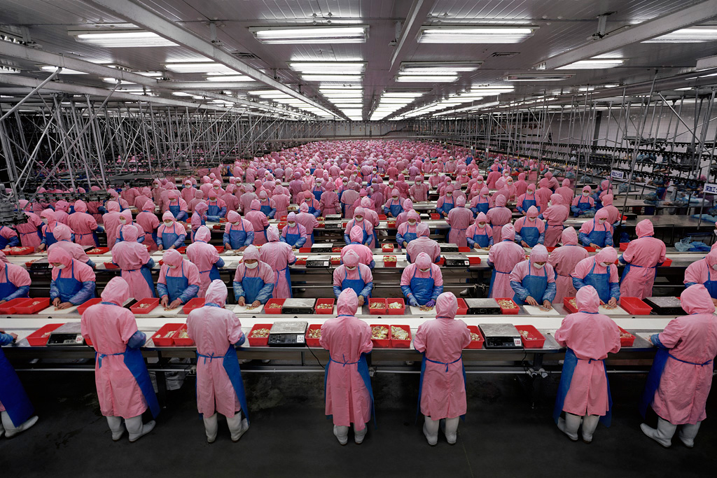
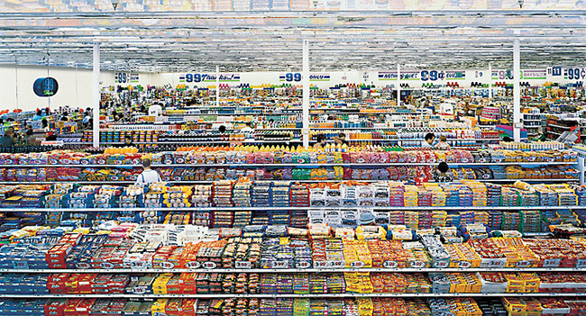
Andreas Gursky

Slide 10
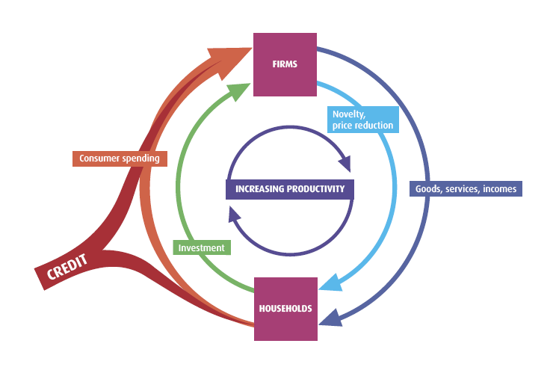
The ‘circular flow’ of the economy
Companies employ people and capital to produce the goods and services that households want and need.
People work for companies in exchange for incomes.
Revenue from the sale allows companies to provide people with incomes.
People spend some of this income on more consumer goods.
But some of it they save.
These savings are invested (directly or indirectly) back into firms.
Notes:
Firms employ people and capital to produce the goods and services that households want and need.
People offer up their labour to firms in exchange for incomes.
Revenue from the sale of goods and services is what allows firms to provide people with incomes.
People spend some of this income on more consumer goods.
But some of it they save. These savings are invested (directly or indirectly) back into firms.
Missing from this over-simplified picture of the economy are what’s called
the public sector (government),
the foreign sector (overseas firms, households and governments)
and the financial sector – which mediates the financial flows of the circular economy

Slide 11
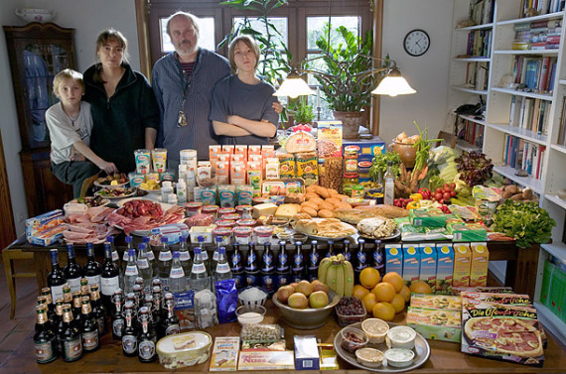
Hungry Planet. What the world eats.Ten Speed Press

Slide 12
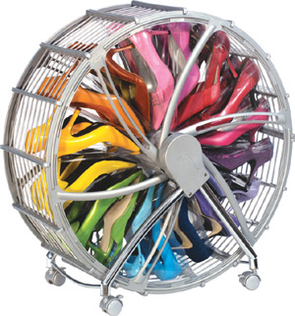
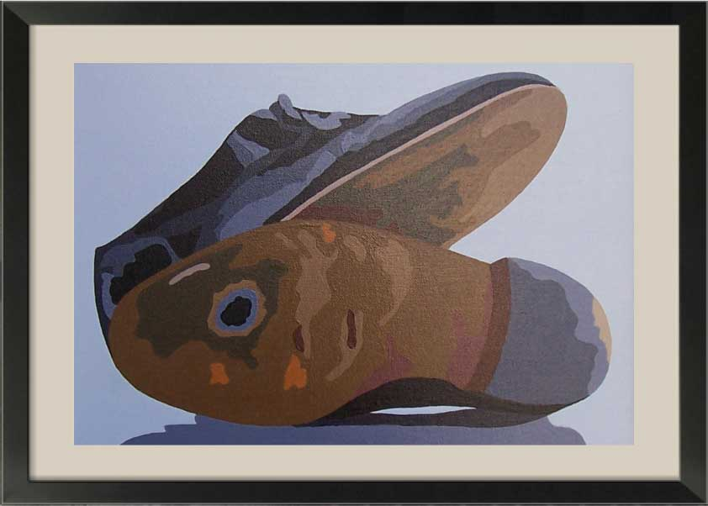
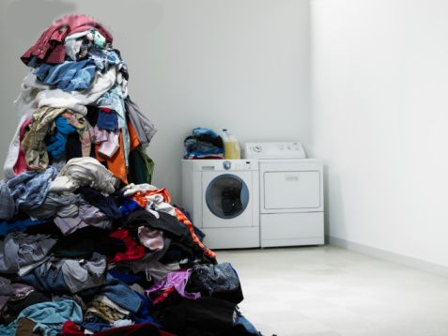
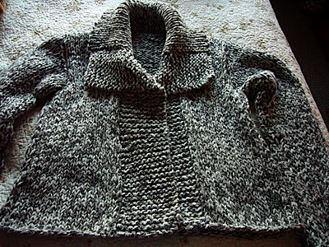

Slide 13
offer
IN-EFFICIENCY OF
THE WHOLE SYSTEM
demand
COST PRESSURE
PRICE PRESSURE
EFFICIENT RETAILER
EFFICIENT PRODUCER
EFFICIENT CONSUMER

Slide 14
REDUCTION OF PRODUCT COSTS
PRICES
EROSION
CONSOLIDATIONS
INNOVATION
PRESSURE

Slide 16
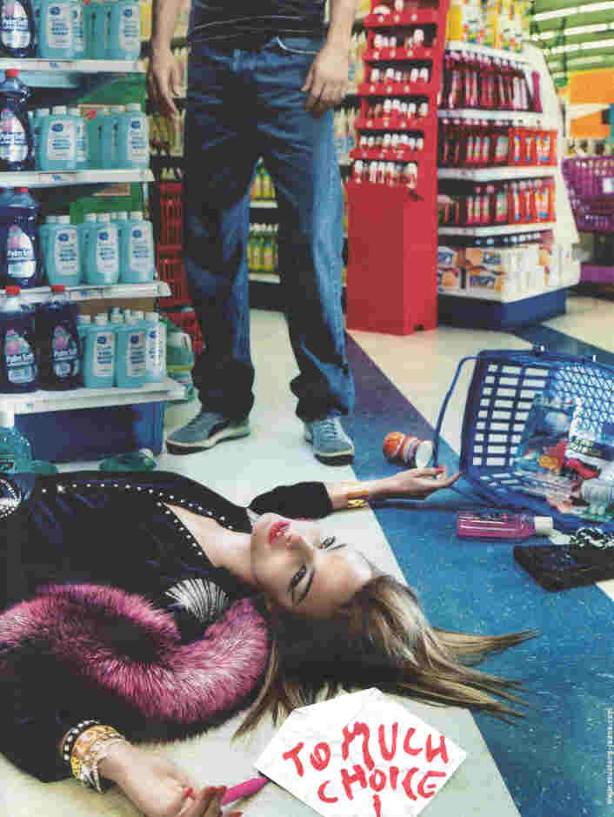
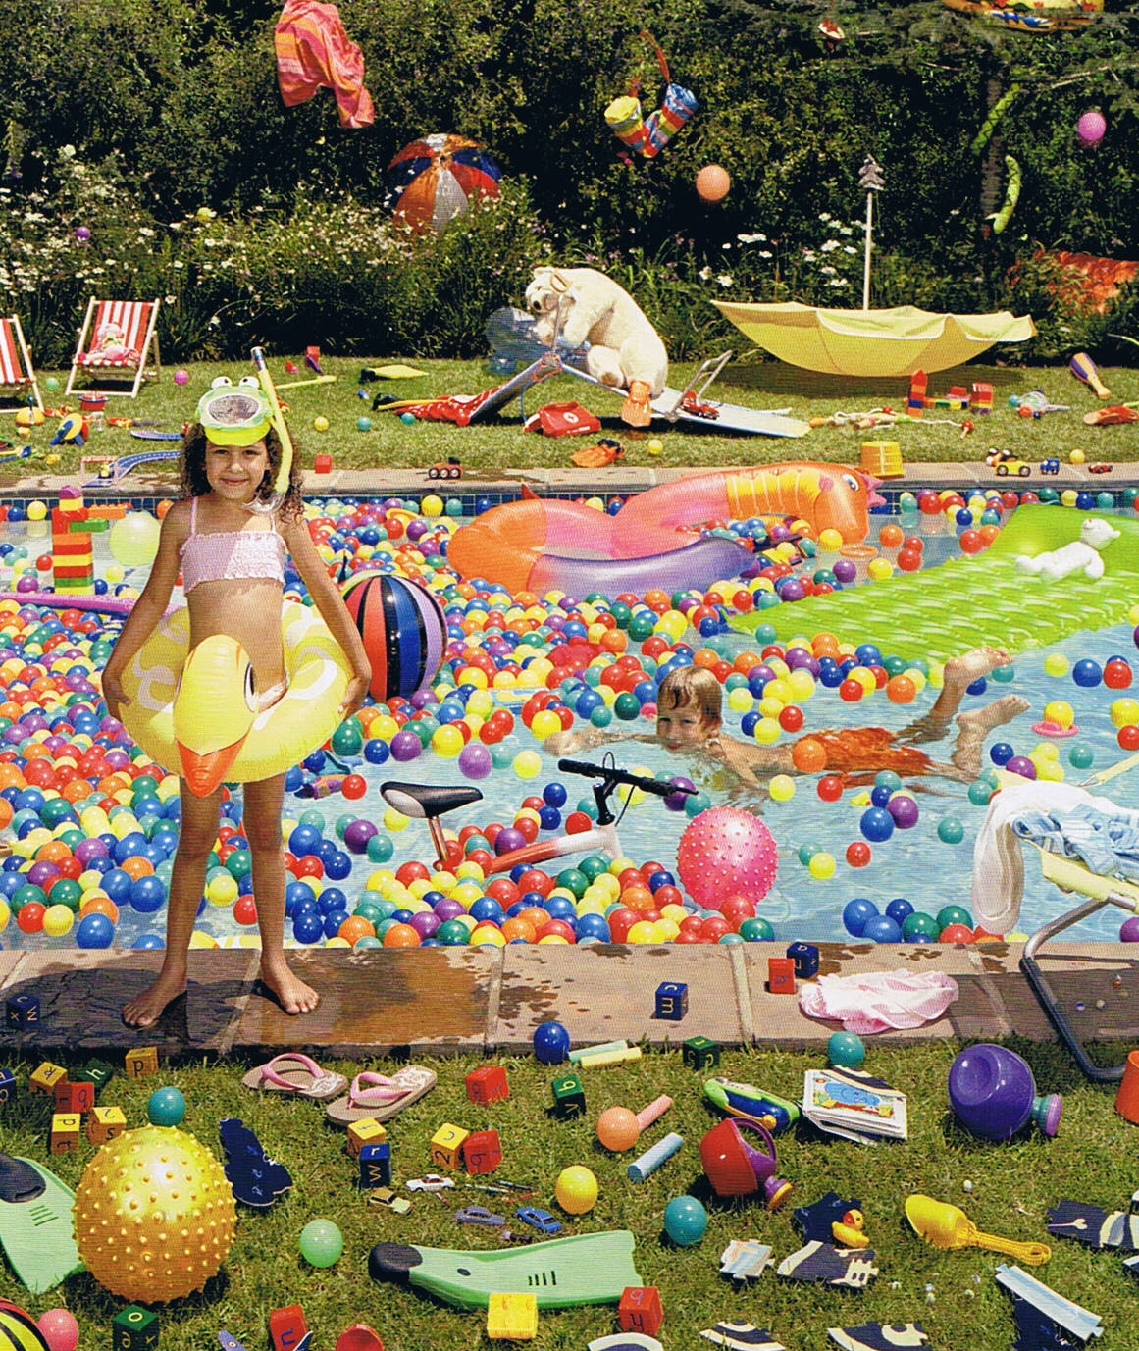
Wallpaper
REALISE THS-HB

Slide 17
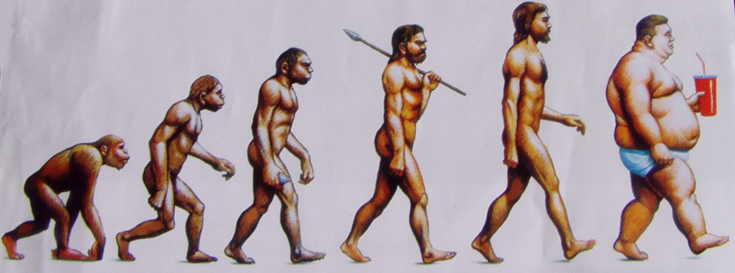
„EXCESS-CIVILISATION“
google
REALISE THS-HB

Slide 18
La Repubblica – The Design of Prosperity
CLEAN
GOOD & FAIR
BEAUTIFUL
REALISE THS-HB

Slide 19
La Repubblica – The Design of Prosperity
CLEAN
GOOD & FAIR
BEAUTIFUL
REALISE THS-HB

Slide 20
La Repubblica – The Design of Prosperity
CLEAN
GOOD & FAIR
BEAUTIFUL
MEANINGFUL
REALISE THS-HB

Slide 21
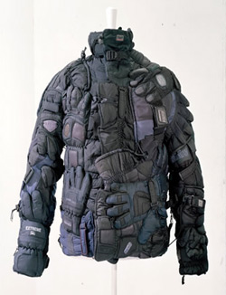
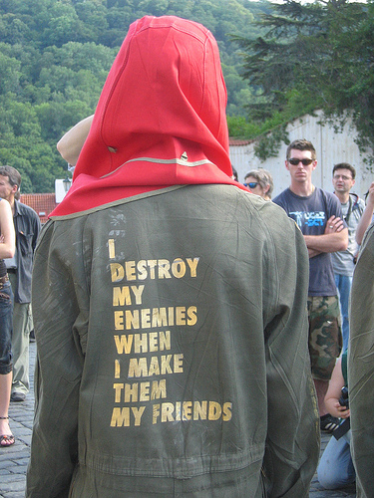
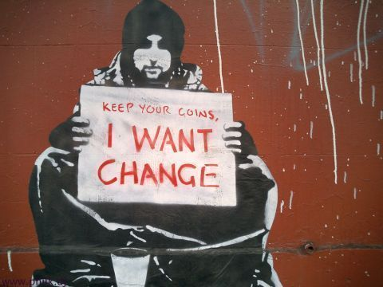
Margiela
Margiela
Bansky

Slide 22
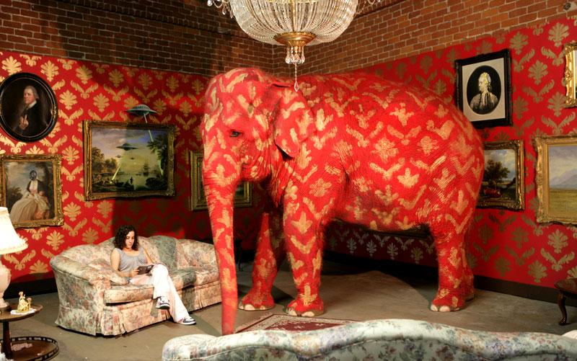
Bansky
REALISE THS-HB

Slide 23
18% WORLD POPULATION
(ca. 800 Mil)
83% GLOBAL INCOME

Slide 24
82% WORLD POPULATION
(ca. 5 Bn)
17% GLOBAL INCOME

Slide 25
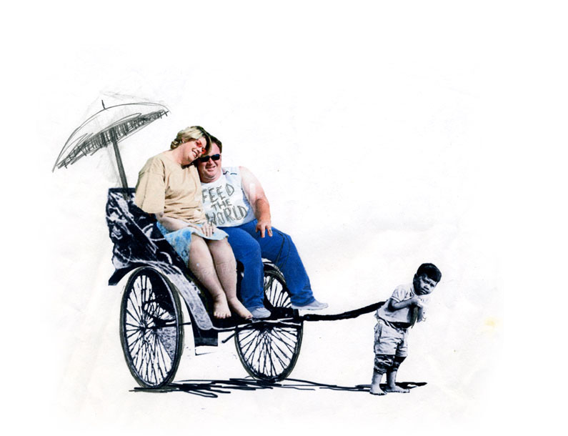
Bansky
REALISE THS-HB

Slide 26
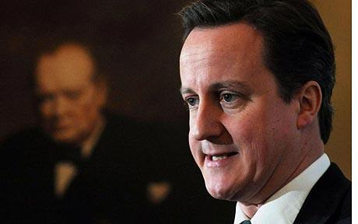
…indeed we will have to change
our whole way of life…

Slide 27
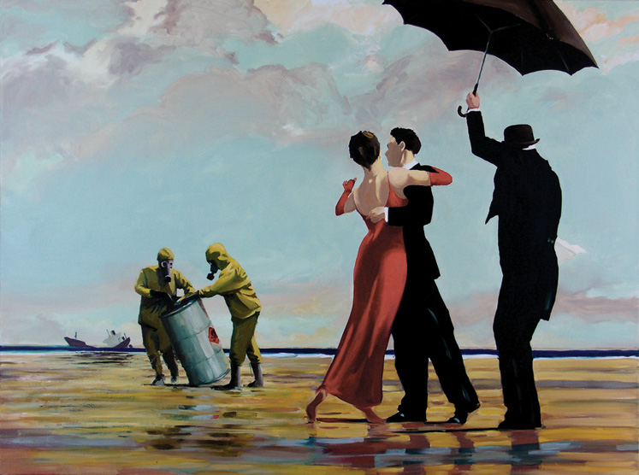

Slide 28
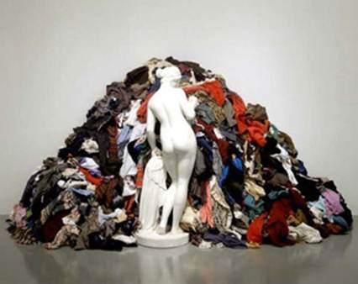

Slide 29
Economy
Culture
Food
Shelter
Clothing
ART
REALISE THS-HB

Slide 30
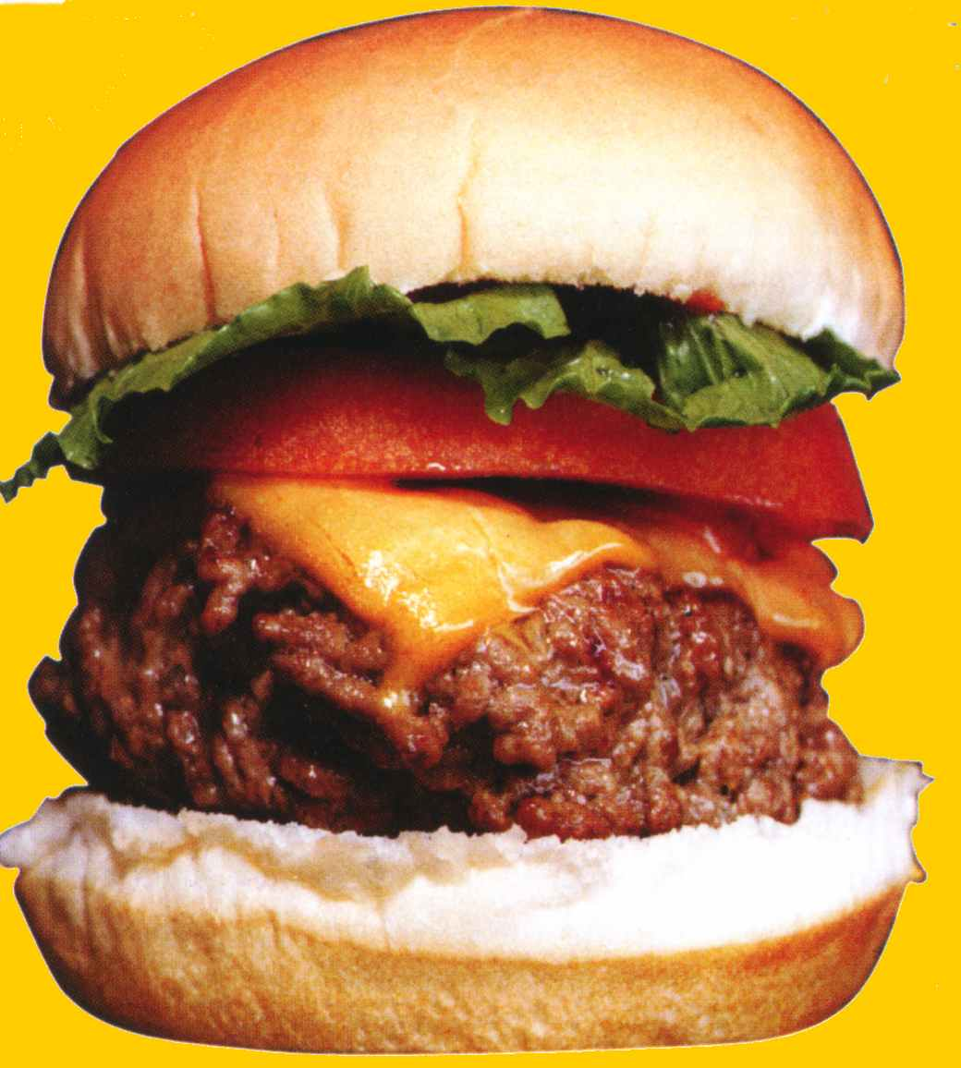
200 $
Creative commons

Slide 31
0,99 $
Creative commons

Slide 32
The Design of New Prosperity and Better Lives:
A Workshop for a
“Food-Shelter-Clothes” Birth to Birth System.
Cittadellarte, Biella, Italy
15, 16, 17 (and 18) October 2010

Slide 33
Delegates of London College of Fashion (LCF) University of the Arts, London Prof. Frances Corner, Head of the LCF, UK Prof. Sandy Black, Professor of Fashion and Textile Design and Technology, UK
Dilys Williams, Director of the Centre for Sustainable Fashion of the LCF, UK
Prof. Helen Storey, Professor of Fashion and Science, Co-Director Centre for Fashion, UK
Delegates invited by LCF
Prof. Tony Ryan, Pro-Vice Chancellor, Faculty of Science, Sheffield University, UK
Dr Marcella Ucci, Lecturer in Facility and Environment Management, UCL Bartlett, UK
Dr Phil Waywell, Scientific Lead for the Catalytic Textiles project LCF/Sheffield University, UK
Donald Sloan, Head of Department of Hospitality, Leisure, Tourism Management at Oxford Brooked University, UK
Andrew Simms, Policy Director of the New Economics Foundation, UK (tbd)

Slide 34
Delegates of The Swedish School of Textiles (THS), University of Borås, Borås Prof. Lisbeth Svengren, Professor in Fashion Management, SE David Goldsmith, THS PhD student, adjunct at Parsons: The New School for Design, USA/SE Prof. Simonetta Carbonaro, Professor of Design Management & Humanistic Marketing, I/DE
Delegates invited by THS
Elena Schneider, Slow Food, Natural Fibers, I (tbd) Prof. Nicola Perullo, Estetica, Università delle Scienze Gastronomiche di Pollenzo, I Prof. Ezio Manzini, Director Unit of Design for Sustainability Polytechnic University of Milan, I Per Stoltz, Green Living , IKEA of Sweden, SE Anna Handshuh, Triodos Bank, DE
Tamara Abu, Director of Fashion Design at Parsons: The New School for Design
Peter Waeber, CEO Bluesign Technologies, CH
Christine Waeber, Bluesign Technologies, CH
Anna Zegna, Image Director of the Ermenegildo Zegna Group, President of Zegna Foundation, Delegate for Ecology and Environment of the Italian Fashion Chamber, I

Slide 35
Delegates of Cittadellarte
Paolo Naldini, Managing Director
Michelangelo Pistoletto, Founder
Tiziani Monterisi, Cittadellarte N.O.V.A. Civitas Design and Architecture, Project leader
Caterina Micolano, Cittadellarte Communications
Federica Ricci, Cittadellarte Fashion B.E.S.T. Project Leader
Delegates invited by Cittadellarte
Delegate of UNCTAD
Delegate of the EU Agency of Textiles Health and Safety
Cesare Losavio, Marzotto Special Projects
Sean Ansett, Burberry Corporate Responsibility Director
Burak Cakmak, Gucci Corporate Sustainability Director
Maurizio Zucchi, Creator Zuchhi Ecoemotion
Maria Luisa Frisa, Fashion Curator, Professor at IUAV, Venice

Slide 36
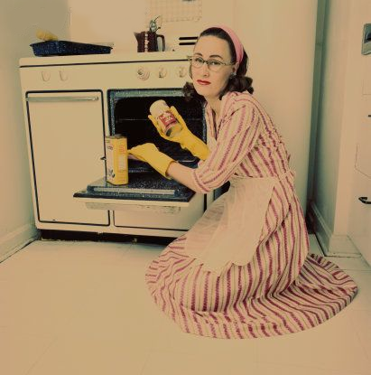
Getty Images

Slide 37
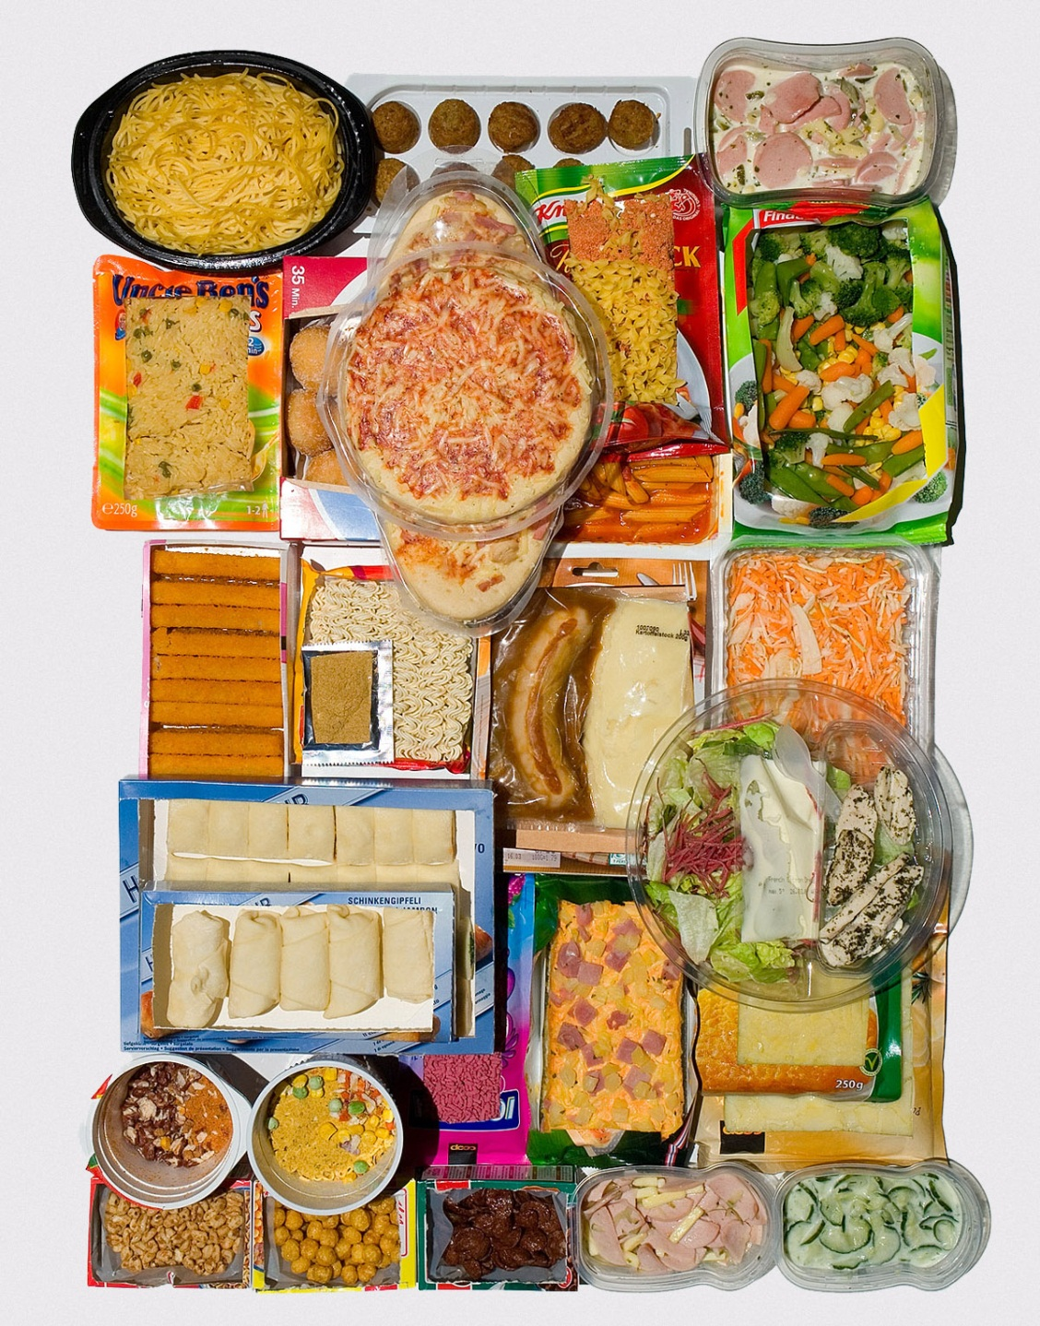
Gettyimages

Slide 38
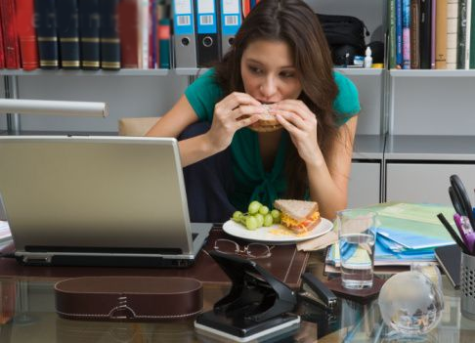
Gettyimages

Slide 40
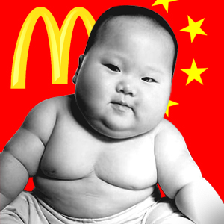
According to the WHO the rate of obesity in China has doubled in 10 years.
Notes:
Will become tangible also in the emerging countries and at a faster speed…

Slide 41
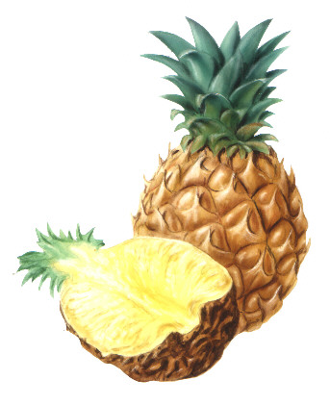
Creative commosn

Slide 42
FAO

Slide 43
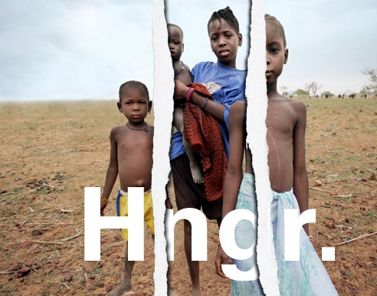
Unicef

Slide 44
Getty Images

Slide 45
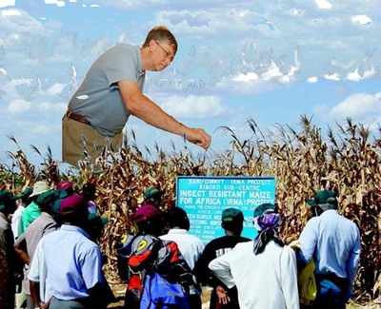
indiadaily.org

Slide 46
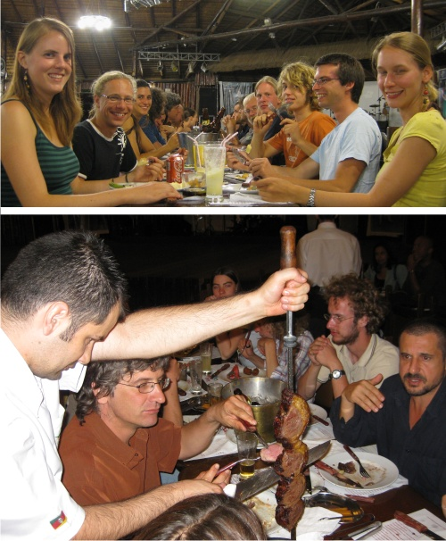
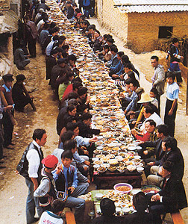
Flickr

Slide 47
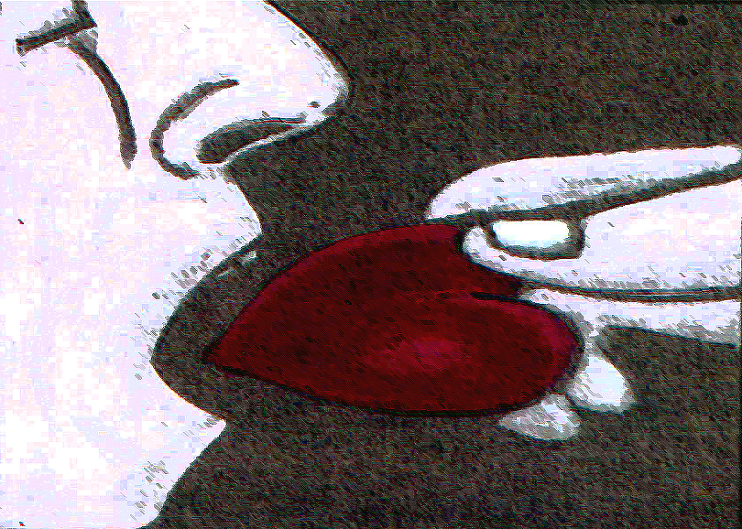
Crative commons

Slide 48
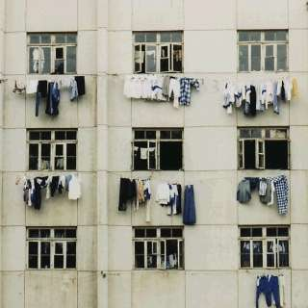

Slide 49
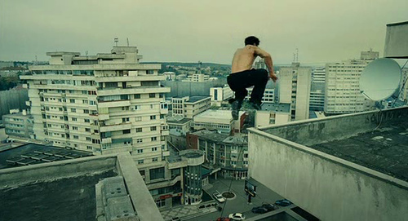

Slide 50
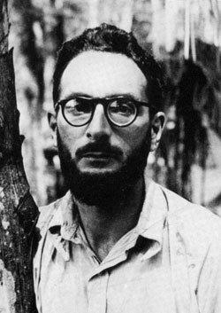
Tristes Tropiques
Lévi-Strauss (1908 / 2009)

Slide 51
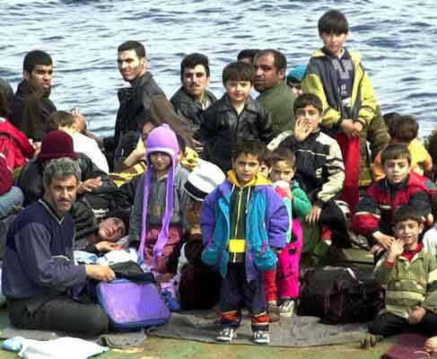

Slide 52
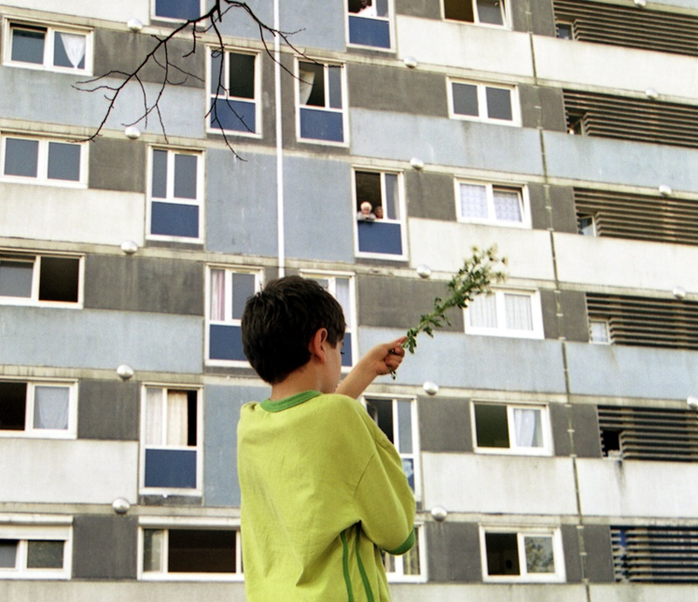

Slide 53
WESTERN
COUNTRY HOME
WESTERN
CITY HOME

Slide 54
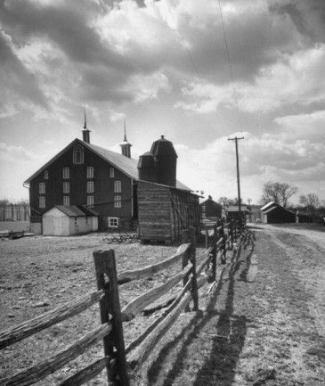
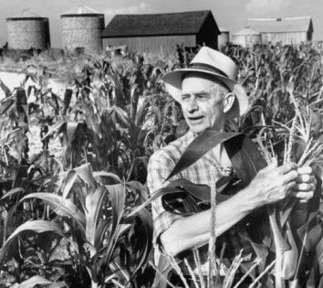

Slide 57
REAL_ISE

Slide 58
REAL_ISE

Slide 60
Unhappy Hipster - Thomas Ibsen
“He couldn’t even make eye contact …
…with the chaise longue.”
REAL_ISE

Slide 61
AFFECTIVE
ERGONOMICS

Slide 63
LaRepubblica

Slide 64
MASSTIGE

Slide 66
LOSS OF CREATIVITY

Slide 67
LOSS OF INSPIRATION

Slide 68
EVERYBODY
IS COPYING
EVERYBODY
IS COPYING
EVERYBODY
IS COPYING
EVERYBODY

Slide 69
Small, Local, Open and Connected: an emerging scenario / Ezio Manzini
The only sustainable way to get out of the current global financial and ecological crisis is to promote new economic models, new production systems and new ideas of wellbeing.
To define and implement these new models is, of course, very difficult.
But it is not impossible. And we do not have to start from zero.
In the last decades, in fact, a multiplicity of social “actors” (institutions, enterprises, non-profit organisations, but also and most of all, individual citizens and their associations) have been capable of acting outside of the mainstream models.
And, by doing so, to create a large amount of concrete experiences that could consolidate, spread and become the most convincing answers to the present dramatic challenges.
Notes:
Small, Local, Open and Connected: an emerging scenario / Ezio Manzini
To define and implement these new models is, of course, very difficult. But it is not impossible. And we do not have to start from zero. In the last decades, in fact, a multiplicity of social “actors” (institutions, enterprises, non-profit organisations, but also and most of all, individual citizens and their associations) have been capable of acting outside of the mainstream models. And, doing so, to create a large amount of concrete experiences that could consolidate, spread and become the most convincing answers to the present dramatic challenges.
The emerging scenario.
Thanks to the promising experiences accumulated to date we can outline a new scenario. This emerging scenario is given by the fact that it can be built at the intersection of three main innovation streams: the green revolution (and the highly environmental friendly systems it makes available); the spread of networks (and the distributed, open, peer-to-peer organisations it generates); the diffuse creativity (and the original answers to daily problems that a variety of social actors are conceiving and implementing). We will refer to it as the SLOC Scenario, where SLOC stands for small, local, open, connected. These four adjectives, in fact, synthesise very well the socio-technical system on which this scenario is based: a distributed production and consumption system where the global is a “network of locals”. That is, it is a mesh of connected local systems the small scale of which makes them comprehensible and controllable by individuals and communities.
The SLOC Scenario is useful because it gives a clear direction of where to look for sustainable solutions. In fact, it indicates that sustainable solutions necessarily refer to the local (and the community to which this local mainly refers) and to the small (and the possibilities in terms of relationships, participation and democracy that the human scale make possible). At the same time, it tells us that to implement solutions, we have to consider these small entities and these localities in the framework of the global network society where the local and the small are both open and connected. This change in the nature of the small and local has enormous implications: with the new networks it becomes possible to operate on a local and small scale in a very effective way. Moreover, these networked systems indicate the one and only possibility to operate in the complex and fast changing environment generated by the present crisis and by the double transition towards a knowledge society and a sustainable society.

Slide 70
The emerging scenario.
Thanks to the promising experiences accumulated to date we can outline a new scenario.
This emerging scenario is given by the fact that it can be built at the intersection of three main innovation streams:
the green innovation (and the highly environmental friendly systems it makes available);
the spread of networks (and the distributed, open, peer-to-peer organisations it generates);
the diffuse creativity (and the original answers to daily problems that a variety of social actors are conceiving and implementing).
SLOC Scenario, where SLOC stands for small, local, open, connected.

Slide 71
The socio-technical system on which this scenario is based:
a distributed production and consumption system where the global is a “network of locals”.
That is, it is a mesh of connected local systems the small scale of which makes them comprehensible and controllable by individuals and communities.
Tthese small entities and these localities are embedded in the framework of the global network society where the local and the small are both open and connected.
Moreover, these networked systems indicate the one and only possibility to operate in the complex and fast changing environment generated by the present crisis and by the double transition towards a knowledge society and a sustainable society.

Slide 72
Mass market turns into masses of niche markets
Excellence
Uniqueness
„less of the best“
ENABLERS
CHALLENGERS
„more for less“
Standard
Notes:
. Mass market turns into masses of niche markets

Slide 75
La Repubblica
REALISE THS-HB

Slide 76
SLOW FOOD
REALISE THS-HB

Slide 77
SLOW LIFE
REALISE THS-HB

Slide 78
SLOW FASHION
DBZ
REALISE THS-HB

Slide 79
REALISE THS-HB
Notes:
SPIEGEL-Verlag

Slide 80
LOHAS:
More than Green-Glamour.
A socio-cultural
Segmentation
REALISE THS-HB

Slide 81
Fragile
REALISE THS-HB

Slide 82
Spiegel
REALISE THS-HB

Slide 83
Flickr
REALISE THS-HB

Slide 84
Spiegel
REALISE THS-HB

Slide 86
Focus
REALISE THS-HB

Slide 87
FOOD
SPRIT
Getty Images

Slide 88
Getty Images
REALISE THS-HB

Slide 90
Bansky
REALISE THS-HB

Slide 91
WHAT IS THE FRAME ?
WHAT IS THE SOCIAL
PROJECT
REALISE THS-HB

Slide 92
PEOPLE
=
CONSUMERS
REALISE THS-HB

Slide 93
CONSUMERS
GOT
CONSUMED
REALISE THS-HB

Slide 94
STAGNATION
CONSUMERS‘ RETENTION
REALISE THS-HB

Slide 95
Hungry Planet. What the world eats.Ten Speed Press
REALISE THS-HB

Slide 96
Sieben Mulden und eine Leiche
REALISE THS-HB
Notes:
Sieben Mulden und eine Leiche

Slide 97
Getty Images
REALISE THS-HB

Slide 98
Getty Images
REALISE THS-HB
Notes:
www.thefinancialhelpcenter.com

Slide 99
Getty Images
REALISE THS-HB

Slide 100
adbusters
REALISE THS-HB
Notes:
Image Credit: Greengaged

Slide 101
BULIMIA ANOREXIA
REALISE THS-HB

Slide 102
QUALITY-PRICE-RATIO
Getty Images
REALISE THS-HB

Slide 103
Getty images
REALISE THS-HB

Slide 104
Google.com
REALISE THS-HB

Slide 105
Food purchase group_Milan
Food purchase group_Taiwan
Emude
REALISE THS-HB

Slide 106
Getty images
REALISE THS-HB

Slide 107
REALISE THS-HB

Slide 108
AUTHENTICITY
TRANSPARENCY
REALISE THS-HB

Slide 109
Fragile
REALISE THS-HB
Notes:
treehugger.com

Slide 110
Getty Images
REALISE THS-HB

Slide 111
THE
HIGH COST
OF LOW COST
REALISE THS-HB

Slide 112
Getty images- Focus
REALISE THS-HB

Slide 113
TECHNOLOGY
IN DIALOGUE
WITH PEOPLE
(not consumers)
REALISE THS-HB

Slide 114
TECHNOLOGY
TALKING WITH
FACTS
(not magics)
REALISE THS-HB

Slide 115
google
REALISE THS-HB

Slide 116
TECHNOLOGY
INVASION
REALISE THS-HB

Slide 117
TECHNOLOGY
LAST MARKETING
GIMMICK
REALISE THS-HB

Slide 118
google
REALISE THS-HB

Slide 119
Getty images
REALISE THS-HB

Slide 120
THE
NEED TO NEED
REALISE THS-HB

Slide 121
Damien Hirst - Google
REALISE THS-HB
Notes:
Damien Hirst

Slide 122
google
REALISE THS-HB

Slide 123
coin-sl.com
REALISE THS-HB

Slide 124
I buy
GOOD
CLEAN
FAIR
products
Flickr -emybloom
REALISE THS-HB

Slide 125
REALISE THS-HB

Slide 126
HAPPY
FRUGALITY
REALISE THS-HB

Slide 127
Realise
REALISE THS-HB

Slide 128
LaRepubblica
REALISE THS-HB

Slide 129
Supermarketing
REALISE THS-HB
Notes:
Supermarketing

Slide 130
Luca Orta
REALISE THS-HB

Slide 131
MIND & SPIRIT
ARE SEXY
REALISE THS-HB

Slide 132
BASIC NEED
PRIMARY QUESTION
REALISE THS-HB

Slide 133
FOOD
CLOTHING
SHELTER
REALISE THS-HB

Slide 134
MAKING
SENSE
REALISE THS-HB

Slide 135
“GREEN”
MARKETING
Trendwatching
REALISE THS-HB

Slide 136
CULTURE
THE ARTS
&
SCIENCE
REALISE THS-HB

Slide 137
NEW CULTURE
OF SUSTAINABLE
WAYS OF LIFE
REALISE THS-HB

Slide 138
“ICONS”
OF SUSTAINABLE
LIFE-STYLES
REALISE THS-HB

Slide 139
“ICONS”
OF SUSTAINABLE
STYLES OF THOUGHT
REALISE THS-HB

Slide 140
ECONOMY
OF
MEANINGFULLNESS
REALISE THS-HB

Slide 141
ECONOMY OF
MEANINGFULNESS
ECONOMY
OF NEEDS
ECONOMY
OF WHISHES
REALISE THS-HB

Slide 142
REALISE THS-HB
Notes:
sembeo.com

Slide 143
Thank-you !
REALISE THS-HB

