Slide 1
Biella, 15-17 October 2010 The Swedish School of Textiles University of Borås

Slide 2
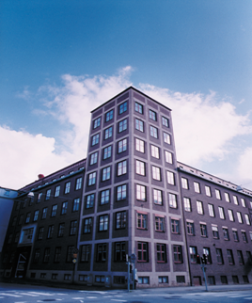
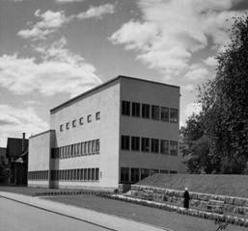
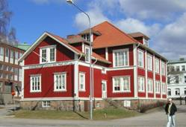
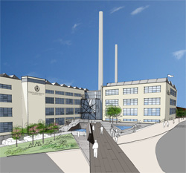
Borås: the textile cluster of Sweden
1866 1946 1986 2013
Simons-land
School of Weaving The Textile Institute Swedish School of Textile and Textiles (THS) Fashion Cluster

Slide 3
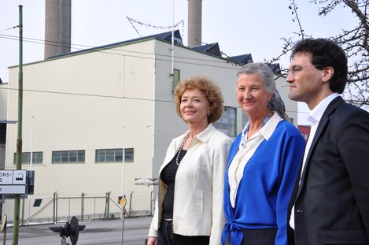
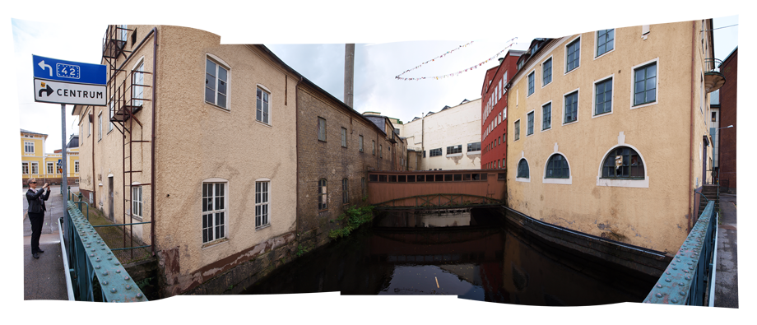

Slide 4
Swedish School of Textiles at University of Borås
D
Fashion-, Textile-, Craft-Design
T
Textile Technology
B&M
Textile Business & Management
F:3
Fashion, Function,
Futures
Full scale laboratories
Knitting, Weaving, Finishing-dyeing-printing, Sewing & assembly

Slide 5
Experimental
R&D
Technology lab..
Design lab.
Business
innovation
Company projects
Prototype factory
An environment for growth
Notes:
The total environment for a successful development of smart textiles.

Slide 6
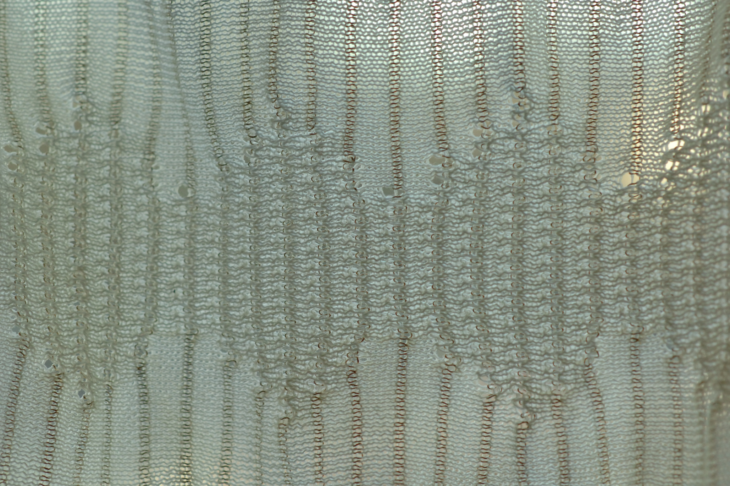
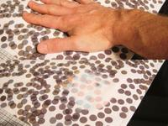

Slide 7
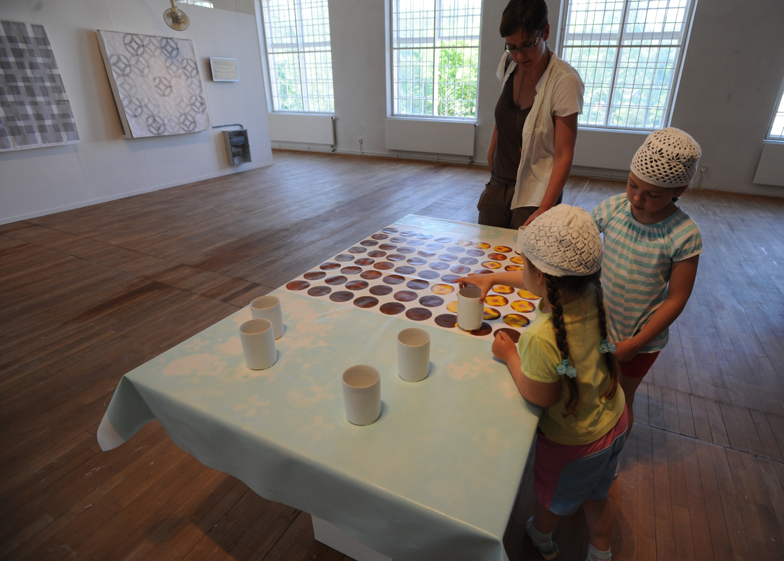

Slide 8
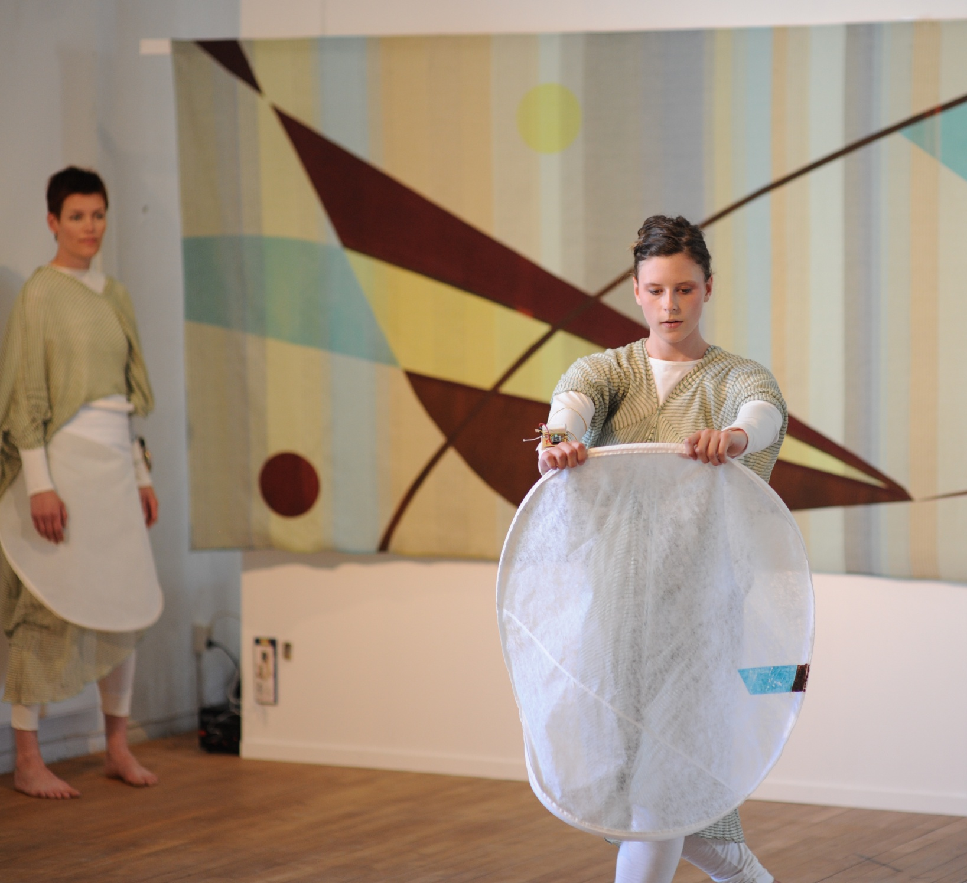

Slide 9
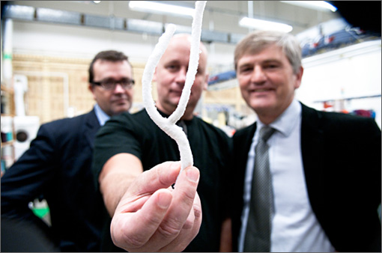

Slide 10
Swedish School of Textiles at University of Borås
D
Fashion-, Textile-, Craft-Design
T
Textile Technology
B&M
Textile Business & Management
F:3
Fashion, Function,
Futures
Full scale laboratories
Knitting, Weaving, Finishing-dyeing-printing, Sewing & assembly

Slide 11
F:3
Fashion,
Function,
Futures
Experimental
R&D
Fashion Market Studio
Artistic Design Studio
Fashion Logistic Studio
Applied
Projects
Design of Prosperity
Integrity & Dignity
Knit on Demand
An environment for creative growth
Notes:
The total environment for a successful development of smart textiles.

Slide 12
The framework of F3 - Fashion Function Futures holds urgent research projects with strong orientation toward application.
Groups of researchers study and explain examples of success and adversity and deliver suggestions for more efficient strategies and contribute to the development of new sustainable products and a sustainable society

Slide 13
The Fashion & Textile Industry
One of the oldest industry
Still a driver for economic development worldwide
Ethical and environmental problems worldwide
”Things are going from bad to worse” (Jonathon Porritt, 2006)

Slide 14
Report from UNEP FI + PRI (principles for Responsible Investment)
The cost for global environmental damages caused by human beings in 2008: 28,000 billions US dollars
= 11 % of the total GNP worldwide
The 3000 largest companies cause 1/3 of this
i.e consumer, oil/gas, metal and mining companies
Clean and resource efficient technologies could decrease the costs by 23%

Slide 15
Consumption of Water
Worldwide:
Agriculture consumes 70 %
Industry consumes 20 %
Domestic use 10 %
Industrial nations: Industry >50%
Changes in lifestyles and eating habits require more water consumption per capita.
Increased production of biofuels has significant impact on water demand. Between 1,000 and 4,000 litres of water are needed to produce a single litre of biofuel.
Accelerating energy demand with corresponding implications for water demand

Slide 16
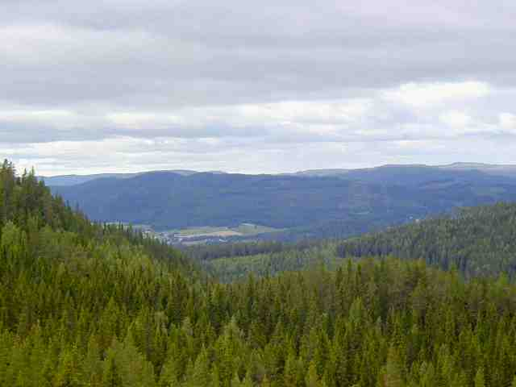
One possibility …

Slide 17
Resources
Global fibre consumption: ~70-80 mill ton
> 50% synthetic fibres (polyester)
~ 35% cotton
~ 5% pulp based fibres
Clothing industry ~ 74% of market value
Home textile ~ 6% of market value
2015-2020 Peak oil and Peak Cotton

Slide 18
Expansions
Increased demand of textile fibres
Expected population growth
3% annual standard increase
the accumulated demand for textile fibre will grow at least 3-fold in 40 years
The end of conventional fibres
The world economy rests on growth
Cotton occupies vast areas of arable land

Slide 19
Consumers’ perceptions
Consumers’ interest in ethical or ecological fashion short-lived media response
Consumers aware of the problem
Consumers do not think it is their responsibility
Consumers are more concerned about ecological food than ecological fashion
Companies will sell what consumers are prepared to pay for
Low prices are still a competitive tool compared to quality

Slide 20
”Expensive cotton change fashion”
Dagens Nyheter, 2/10 2010
103.19 US cent per pund
100
75
50
25
2005 2010

Slide 21
”The increased cost will be neutralized through
changes in design. For example you take away
a pocket, or reduce length. If the trendy colour
will be white next we know why …”
Åke Weyler, consultant for Textile importers

Slide 22
”If the market can take increased prices the clothes will become more expensive.”
Åke Weyler

Slide 23
Futures
The challenges that lie ahead the textile and fashion industry in addressing the economic growth factor and a responsible approach to the future of the planet and all its inhabitants.

Slide 24
Textile & Fashion
Consumers/ users/people
Idea
fibres products
Resource management
and recycling

Slide 25
Fashion Management Research at University of Borås
Textile + Engineering + Business departments
Studios at School of Textiles:
Fashion Design studio
Fashion Market studio
Fashion Supply Chain studio
F3+ studio – the shared platform

Slide 26
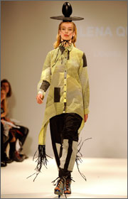
Changing fibres (Forest & Function) F:2
A research project within F:3
A long-term research project with company partners and an international research network
Application to Swedish funding agency: KK Stiftelsen (Knowledge & Compentce Foundation)

Slide 27
Changing fibres …
Fibres from pulp replacing some of the main fibres today
Forest based fibres represent 3-4% of the total textile fibre consumption
The forest, pulp and paper industry in the Northern hemisphere concerned of their future competitiveness
Research plans launched to combine the world’s leading Swedish forest cluster with the globally well-established business cluster including performance wear, home-textiles, furnitures, protective clothing and fashion companies

Slide 28
Pulp Fashion
Holistic approach to the whole value chain
Changing demand by action-based R&D activities in design and improved fabric properties
Production methods and technology for key processes
Communication R&D in order to raise awareness about the properties, etc – in order to strengthen marketing strategies
Studies aiming for increased brand value effects
Logistics (potential Swedish raw material)
Resource recovery
Cradle to cradle mission

Slide 29
The outcomes …
The overall objective is to achieve an increased use of renewable fibres in textile, fashion and function related to products

Slide 30
The MISTRA CALL
Sustainable Fashion
International consortiums
Commitment from industrial partners
In Sweden: from fast fashion to sustainable fashion

Slide 31
Opportunity for
Idea generation
Networkning
Action research
Networking
New models for sustainable fashion
Networking
….

Slide 32
Tangible results
Shift of preferences among the market actors and consumers
More man-made fibre products in the participating companies’ product ranges
Improved product properties through new technologies
Demonstrators early in the project
Effective (ECO2) supply chains supported by practical management tools

